Slide 1
Configuration Management
UNIT – V

Slide 2
Contents
Software Configuration Management (SCM)
Software Configuration Items (SCI)
SCM Process & Goals of SCM
Identification of Objects in the Software Configuration
Configuration management & Maintenance plan
Change Management Version and Release Management
Configuration Management Tools

Slide 3
SCM
Software Configuration Management(SCM) is a process to systematically manage, organize, and control the changes in the documents, codes, and other entities during the Software Development Life Cycle.
When we develop software, the product (software) undergoes many changes in their maintenance phase; we need to handle these changes effectively.
Several individuals (programs) works together to achieve these common goals. This individual produces several work product (SC Items) e.g., Intermediate version of modules or test data used during debugging, parts of the final product.
The elements that comprise all information produced as a part of the software process are collectively called a software configuration.
As software development progresses, the number of Software Configuration elements (SCI's) grow rapidly. These are handled and controlled by SCM. This is where we require software configuration management.

Slide 4
SCM
A configuration of the product refers not only to the product's constituent but also to a particular version of the component.
Therefore, SCM is the discipline which
Identify change
Monitor and control change
Ensure the proper implementation of change made to the item.
Auditing and reporting on the change made.
Configuration Management (CM) is a technic of identifying, organizing, and controlling modification to software being built by a programming team.
The objective is to maximize productivity by minimizing mistakes (errors).

Slide 5
Need for SCM
There are multiple people working on software which is continually updating
It may be a case where multiple version, branches, authors are involved in a software config project, and the team is geographically distributed and works concurrently
Changes in user requirement, policy, budget, schedule need to be accommodated.
Software should able to run on various machines and Operating Systems
Helps to develop coordination among stakeholders
SCM process is also beneficial to control the costs involved in making changes to a system
Any change in the software configuration Items will affect the final product. Therefore, changes to configuration items need to be controlled and managed.

Slide 6
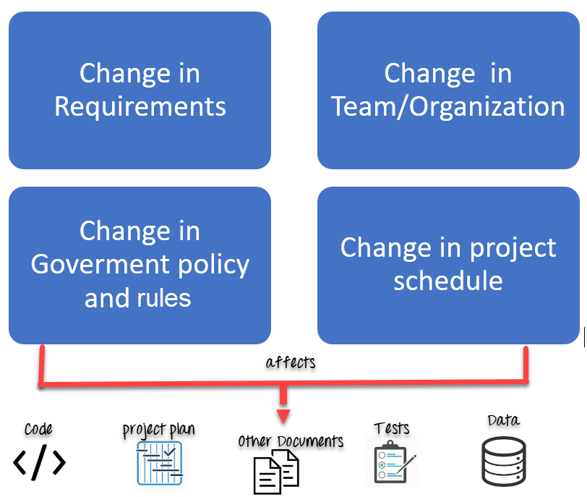
Need for SCM

Slide 7
Importance of SCM
It is practical in controlling and managing the access to various SCIs e.g., by preventing the two members of a team for checking out the same component for modification at the same time.
It provides the tool to ensure that changes are being properly implemented.
It has the capability of describing and storing the various constituent of software.
SCM is used in keeping a system in a consistent state by automatically producing derived version upon modification of the same component.

Slide 8
Tasks in SCM process
Configuration Identification
Baselines
Change Control
Configuration Status Accounting
Configuration Audits and Reviews

Slide 9
Configuration Identification:
Configuration identification is a method of determining the scope of the software system. With the help of this step, you can manage or control something even if you don't know what it is. It is a description that contains the CSCI type (Computer Software Configuration Item), a project identifier and version information.
Activities during this process:
Identification of configuration Items like source code modules, test case, and requirements specification.
Identification of each CSCI in the SCM repository, by using an object-oriented approach
The process starts with basic objects which are grouped into aggregate objects. Details of what, why, when and by whom changes in the test are made
Every object has its own features that identify its name that is explicit to all other objects
List of resources required such as the document, the file, tools, etc.
Example: Instead of naming a File login.php its should be named login_v1.2.php where v1.2 stands for the version number of the file. Or instead of naming folder "Code" it should be named "Code_D" where D represents code should be backed up daily.

Slide 10
Baseline
A baseline is a formally accepted version of a software configuration item. It is designated and fixed at a specific time while conducting the SCM process. It can only be changed through formal change control procedures.
Activities during this process:
Facilitate construction of various versions of an application
Defining and determining mechanisms for managing various versions of these work products
The functional baseline corresponds to the reviewed system requirements
Widely used baselines include functional, developmental, and product baselines
In simple words, baseline means ready for release.

Slide 11
Change Control
Change control is a procedural method which ensures quality and consistency when changes are made in the configuration object. In this step, the change request is submitted to software configuration manager.
Activities during this process:
Control ad-hoc change to build stable software development environment. Changes are committed to the repository
The request will be checked based on the technical merit, possible side effects and overall impact on other configuration objects.
It manages changes and making configuration items available during the software lifecycle

Slide 12
Configuration Status Accounting
Configuration status accounting tracks each release during the SCM process. This stage involves tracking what each version has and the changes that lead to this version.
Activities during this process:
Keeps a record of all the changes made to the previous baseline to reach a new baseline
Identify all items to define the software configuration
Monitor status of change requests
Complete listing of all changes since the last baseline
Allows tracking of progress to next baseline
Allows to check previous releases/versions to be extracted for testing

Slide 13
Configuration Audits and Reviews
Software Configuration audits verify that all the software product satisfies the baseline needs. It ensures that what is built is what is delivered.
Activities during this process:
Configuration auditing is conducted by auditors by checking that defined processes are being followed and ensuring that the SCM goals are satisfied.
To verify compliance with configuration control standards. auditing and reporting the changes made
SCM audits also ensure that traceability is maintained during the process.
Ensures that changes made to a baseline comply with the configuration status reports
Validation of completeness and consistency

Slide 14
Participant of SCM process
Configuration Manager
Configuration Manager is the head who is Responsible for identifying configuration items.
CM ensures team follows the SCM process
He/She needs to approve or reject change requests
Developer
The developer needs to change the code as per standard development activities or change requests. He is responsible for maintaining configuration of code.
The developer should check the changes and resolves conflicts
Auditor
The auditor is responsible for SCM audits and reviews.
Need to ensure the consistency and completeness of release.

Slide 15
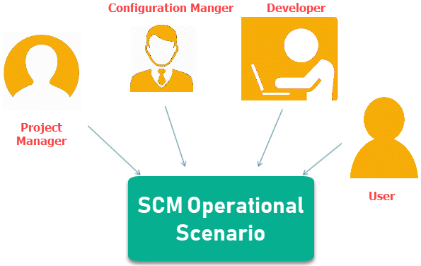
Participant of SCM process
Project Manager:
Ensure that the product is developed within a certain time frame
Monitors the progress of development and recognizes issues in the SCM process
Generate reports about the status of the software system
Make sure that processes and policies are followed for creating, changing, and testing
User
The end user should understand the key SCM terms to ensure he has the latest version of the software

Slide 16
Software Configuration Management Plan
The SCMP (Software Configuration management planning) process planning begins at the early coding phases of a project. The outcome of the planning phase is the SCM plan which might be stretched or revised during the project.
The SCMP can follow a public standard like the IEEE 828 or organization specific standard
It defines the types of documents to be management and a document naming. Example Test_v1
SCMP defines the person who will be responsible for the entire SCM process and creation of baselines.
Fix policies for version management & change control
Define tools which can be used during the SCM process
Configuration management database for recording configuration information.

Slide 17
Software Configuration Management Tools
Any Change management software should have the following 3 Key features:
Concurrency Management:
When two or more tasks are happening at the same time, it is known as concurrent operation. Concurrency in context to SCM means that the same file being edited by multiple persons at the same time.
If concurrency is not managed correctly with SCM tools, then it may create many pressing issues.
Version Control:
SCM uses archiving method or saves every change made to file. With the help of archiving or save feature, it is possible to roll back to the previous version in case of issues.
Synchronization:
Users can checkout more than one files or an entire copy of the repository. The user then works on the needed file and checks in the changes back to the repository.They can synchronize their local copy to stay updated with the changes made by other team members.

Slide 18
Thank You!

